Slide 1
GUI Components

Slide 2
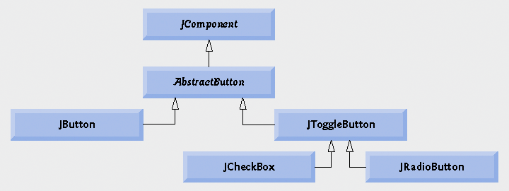


JButton
Abstract Button
  Component user clicks to trigger a specific action
  Can be command button, check box, toggle button or radio button
  Button types are subclasses of class AbstractButton

Slide 3
JButton
Command button
  Generates an ActionEvent when it is clicked
  Created with class JButton
  Text on the face of the button is called button label

Slide 4
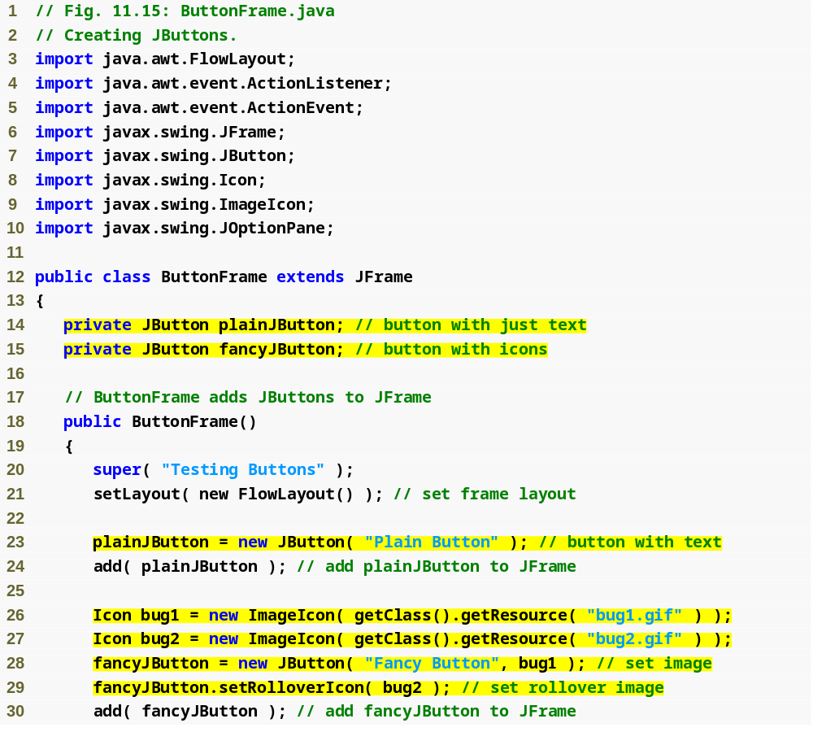
Outline
ButtonFrame.java
(1 of 2)
Declare two JButton instance variables
Create new JButton
Create two ImageIcons
Create new JButton
Set rollover icon for JButton

Slide 5
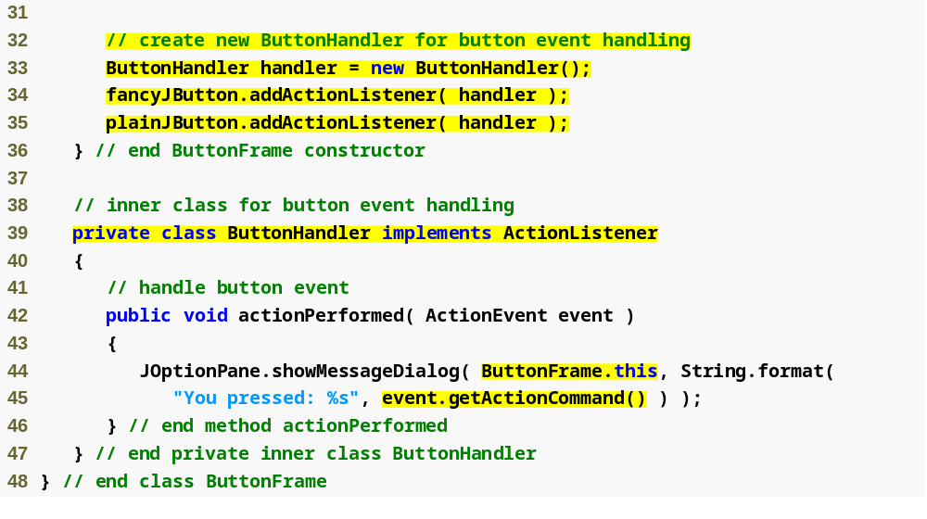
Outline
Create handler for buttons
ButtonFrame.java
(2 of 2)
Register event handlers
Inner class implements ActionListener
Access outer class’s instance using this reference
Get text of JButton pressed

Slide 6
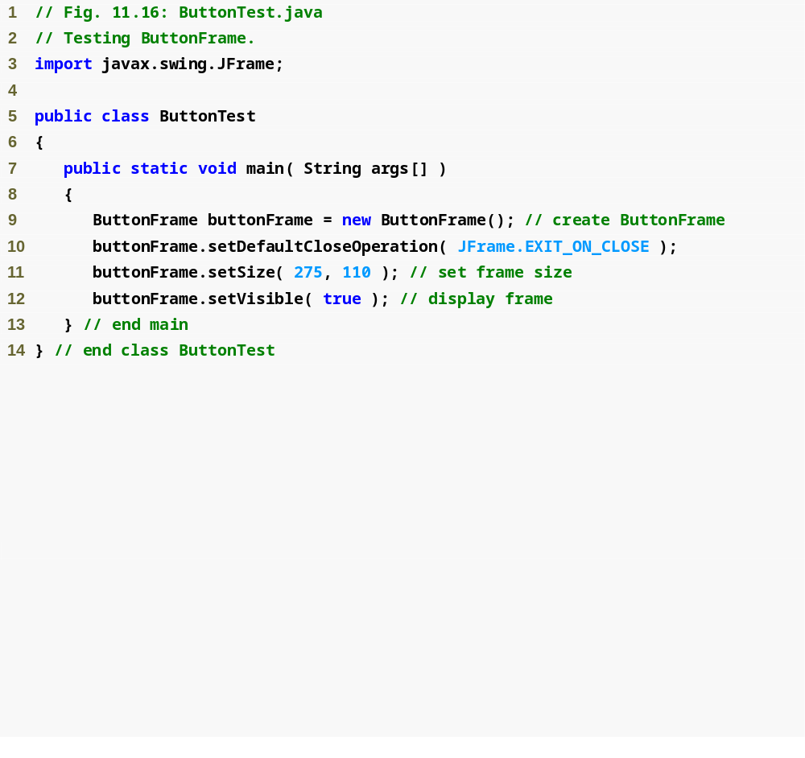
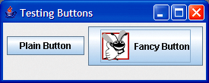
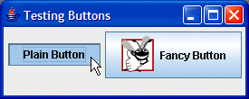
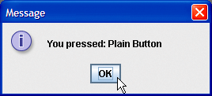
Outline
ButtonTest.java
(1 of 2)

Slide 7

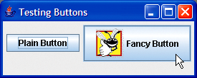
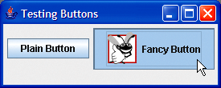
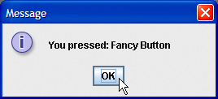
Outline
ButtonTest.java
(2 of 2)

Slide 8
JButton
JButtons can have a rollover icon
  Appears when mouse is positioned over a button
  Added to a JButton with method setRolloverIcon

Slide 9
Software Engineering Observation 11.4
When used in an inner class, keyword this refers to the current inner-class object being manipulated. An inner-class method can use its outer-class object’s this by preceding this with the outer-class name and a dot, as in ButtonFrame.this.

Slide 10
Buttons That Maintain State
State buttons
  Swing contains three types of state buttons
  JToggleButton, JCheckBox and JRadioButton
  JCheckBox and JRadioButton are subclasses of JToggleButton

Slide 11
Using an Anonymous Inner Class for Event Handling
Anonymous inner class
  Special form of inner class
  Declared without a name
  Typically appears inside a method call
  Has limited access to local variables

Slide 12
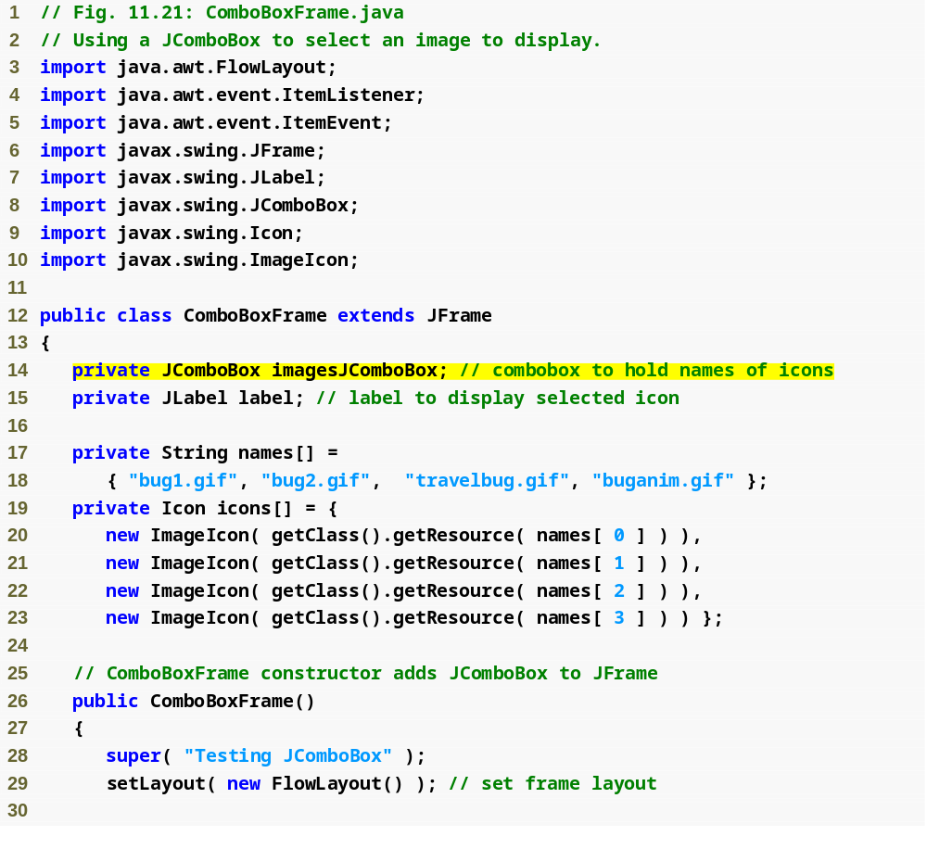
Outline
ComboBoxFrame
.java
(1 of 2)
Declare JComboBox instance variable

Slide 13
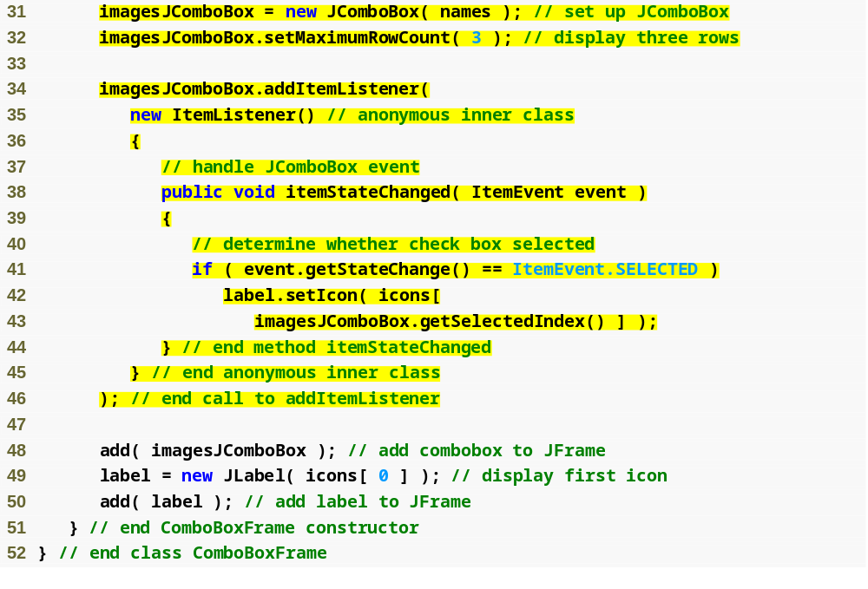
Outline
Create JComboBox and set maximum row count
Create anonymous inner class as the event handler
ComboBoxrame
.java
(2 of 2)
Declare method itemStateChanged
Test state change of JComboBox
Method getSelectedIndex locates selected item

Slide 14
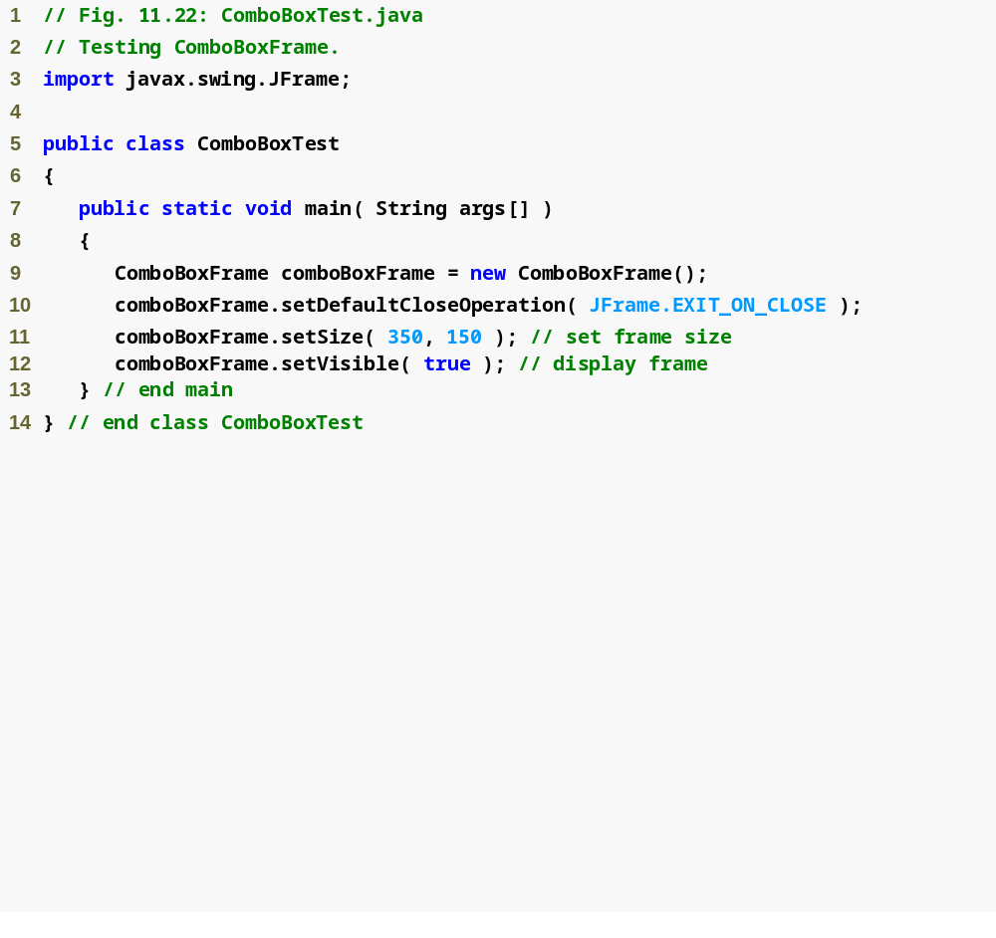
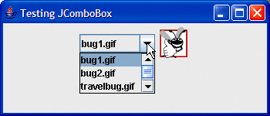
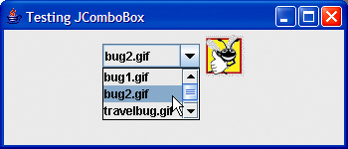
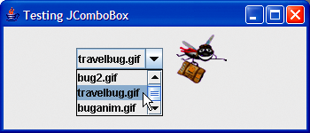
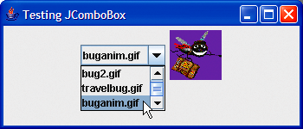
Outline
ComboBoxTest
.java
Scrollbar to scroll through the
items in the list
scroll arrows
scroll box

Slide 15
JPanel
The JPanel class provides general-purpose containers for lightweight components. By default, panels do not add colors to anything except their own background; however, you can easily add borders to them and otherwise customize their painting.
Examples:
JPanel p1 = new JPanel(new BorderLayout());
JPanel p2 = new JPanel();
p2.setLayout(new FlowLayout());
p1.add(aComponent);
p1.add(anotherComponent);

